Slide 1


<AMRITHA H>
<28-08-2024>

Slide 2

Outline
Executive Summary
Introduction
Methodology
Results
Conclusion
Appendix

Slide 3
Executive Summary
Summary of methodologies
Data collection
Data wrangling
Exploratory Data Analysis with Data Visualization
Exploratory Data Analysis with SQL
Building an interactive map with Folium
Building a Dashboard with PlotlY Dash - Predictive analysis (Classification
Summary of all results
Exploratory Data Analysis results
Interactive analytics demo in screenshots
Predictive analysis results

Slide 4
Introduction
Project background and context
SpaceX is the most successful company of the commercial space age we can determine the cost of a launch. Based on public information and machine learning models, we are going to predict if SpaceX will reuse the first stage.
Problems you want to find answers
How do variables such as payload mass, launch site, number of flights, and orbits affect the success of the first stage landing?
Does the rate of successful landings increase over the years? –
What is the best algorithm that can be used for binary classification in this case?

Slide 5

Section 1

Slide 6
Methodology
Executive Summary
Data collection methodology:
SpaceX REST API • Web Scrapping from Wikipedia
Perform data wrangling
Dropping unnecessary columns • One Hot Encoding for classification models
Describe how data was processed
Perform exploratory data analysis (EDA) using visualization and SQL
Perform interactive visual analytics using Folium and Plotly Dash
Perform predictive analysis using classification models
How to build, tune, evaluate classification models

Slide 7
Data Collection
Datasets are collected from Rest SpaceX API and webscrapping Wikipedia
• The information obtained by the API are rocket, launches, payload information.
• The Space X REST API URL is api.spacexdata.com/v4/
• The information obtained by the webscrapping of Wikipedia are launches, landing, payload information.
• URL is https://en.wikipedia.org/w/index.php?title=List_of_Falcon_9_and_Falcon_Heavy_launches&oldid=1027686922

Slide 8
Data Collection - Scraping
Present your web scraping process using key phrases and flowcharts
Add the GitHub URL of the completed web scraping notebook, as an external reference and peer-review purpose
Requesting Falcon 9 launch data from Wikipedia
Creating a BeautifulSoup object from the HTML response
Extracting all column names from the HTML table header
Collecting the data by parsing HTML table
Constructing data we have obtained into a dictionary
Creating a dataframe from the dictionary
Exporting the data to CSV

Slide 9
Data Collection – SpaceX API
Getting Response from Api
Convert Response to JSON File
Transform data
. Create dictionary with data
Create dataframe
Filter dataframe
Export to file
Present your data collection with SpaceX REST calls using key phrases and flowcharts
Add the GitHub URL of the completed SpaceX API calls notebook (must include completed code cell and outcome cell), as an external reference and peer-review purpose

Slide 10
Data Wrangling
Perform exploratory Data Analysis and determine Training
Labels Calculate the number of launches on each site
Calculate the number and occurrence of each orbit
Calculate the number and occurrence of mission outcome per orbit type
Create a landing outcome label from Outcome column
Exporting the data to CSV

Slide 11
EDA with Data Visualization
Charts were plotted: Flight Number vs. Payload Mass
Flight Number vs. Launch Site
Payload Mass vs. Launch Site
Orbit Type vs. Success Rate
Flight Number vs. Orbit Type
Payload Mass vs Orbit Type
Success Rate Yearly Trend Scatter plots show the relationship between variables.
Line charts show trends in data over time (time series)

Slide 12
EDA with SQL
SQL queries to gather and understand data from dataset:
Displaying the names of the unique launch sites in the space mission.
Display 5 records where launch sites begin with the string 'CCA’
Display the total payload mass carried by boosters launched by NASA (CRS).
Display average payload mass carried by booster version F9 v1.1.
Display average payload mass carried by booster version F9 v1.1.
Display average payload mass carried by booster version F9 v1.1.
. List the date when the first successful landing outcome in ground pad was achieved.
.
List the date when the first successful landing outcome in ground pad was achieved.
List the names of the boosters which have success in drone ship and have payload mass greater than 4000 but less than 6000.
List the total number of successful and failure mission outcomes.
List the names of the booster versions which have carried the maximum payload mass.
List the records which will display the month names, failure landing outcomes in drone ship, booster versions, launch site for the months in year 2015.
Rank the count of successful landing outcomes between the date 04-06-2010 and 20-03-2017 in descending order.

Slide 13
Build an Interactive Map with Folium
Folium map object is a map centered on NASA Johnson Space Center at Houston, Texas
• Red circle at NASA Johnson Space Center's coordinate with label showing its name (folium.Circle, folium.map.Marker).
• Red circles at each launch site coordinates with label showing launch site name (folium.Circle, folium.map.Marker, folium.features.DivIcon).
• The grouping of points in a cluster to display multiple and different information for the same coordinates (folium.plugins.MarkerCluster).
• Markers to show successful and unsuccessful landings. Green
for successful landing and Red for unsuccessful landing. (folium.map.Marker, folium.Icon).
• Markers to show distance between launch site to key locations (railway, highway, coastway, city) and plot a line between them. (folium.map.Marker, folium.PolyLine, folium.features.DivIcon)
• These objects are created in order to understand better the problem and the data. We can show easily all launch sites, their surroundings and the number of successful and unsuccessful landing

Slide 14
Build a Dashboard with Plotly Dash
Dashboard has dropdown, pie chart, rangeslider and scatter plot components
• Dropdown allows a user to choose the launch site or all launch sites (dash_core_components.Dropdown).
• Pie chart shows the total success and the total failure for the launch site chosen with the dropdown component (plotly.express.pie).
• Rangeslider allows a user to select a payload mass in a fixed range (dash_core_components.RangeSlider).
• Scatter chart shows the relationship between two variables, in particular Success vs Payload Mass (plotly.express.scatter

Slide 15
Predictive Analysis (Classification)
• Training GridSearchModel models with training dataset
• Model evaluation
Get best hyperparameters for each type of model
• Compute accuracy for each model with test dataset
• Plot Confusion Matrix
• Model comparison
• Comparison of models according to their accuracy
• The model with the best accuracy will be chosen
Data preparation
Load dataset
Normalize data
Split data into training and test sets.
Model preparation
Selection of machine learning algorithms
Set parameters for each algorithm to GridSearchCV
Training GridSearchModel models with training dataset

Slide 16
Results
Exploratory data analysis results
Interactive analytics demo in screenshots
Predictive analysis results

Slide 17

Section 2

Slide 18
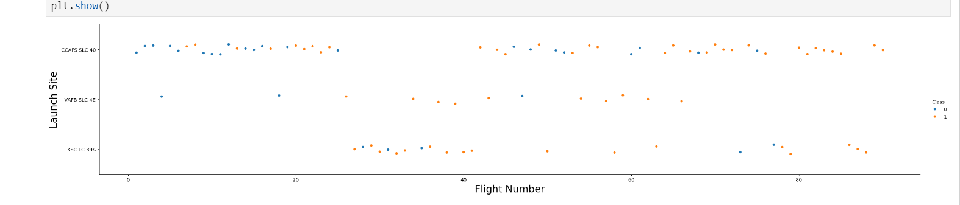
Flight Number vs. Launch Site

Slide 19
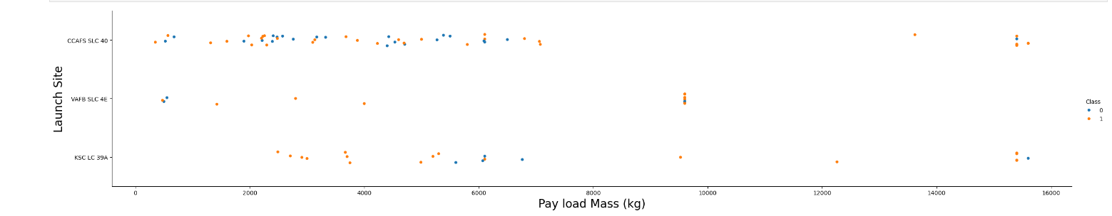
Payload vs. Launch Site

Slide 20
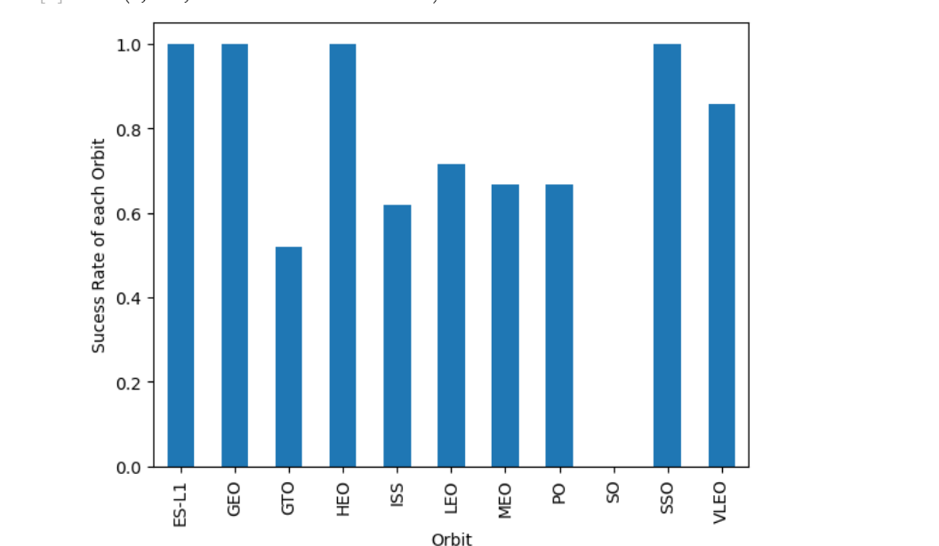
Success Rate vs. Orbit Type

Slide 21
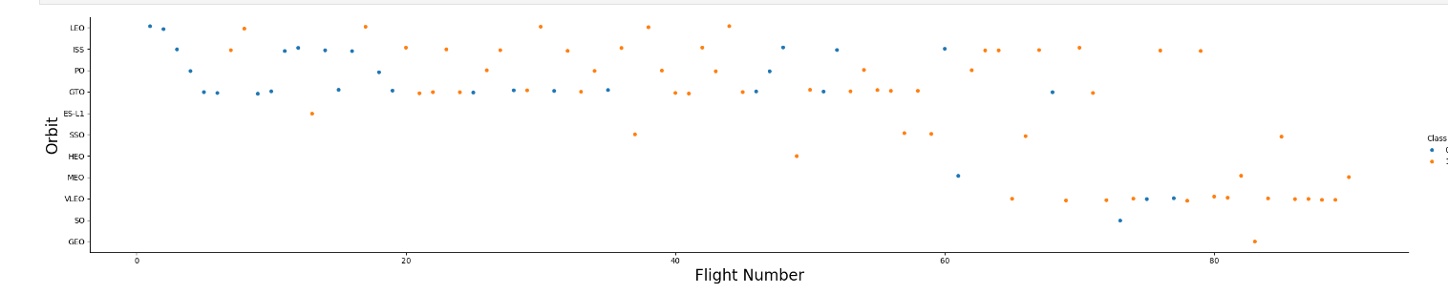
Flight Number vs. Orbit Type
Show a scatter point of Flight number vs. Orbit type
Show the screenshot of the scatter plot with explanations

Slide 22
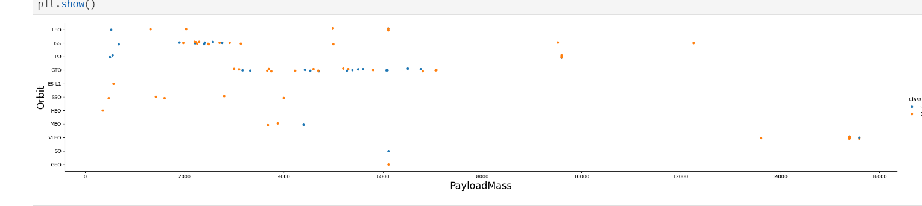
Payload vs. Orbit Type

Slide 23
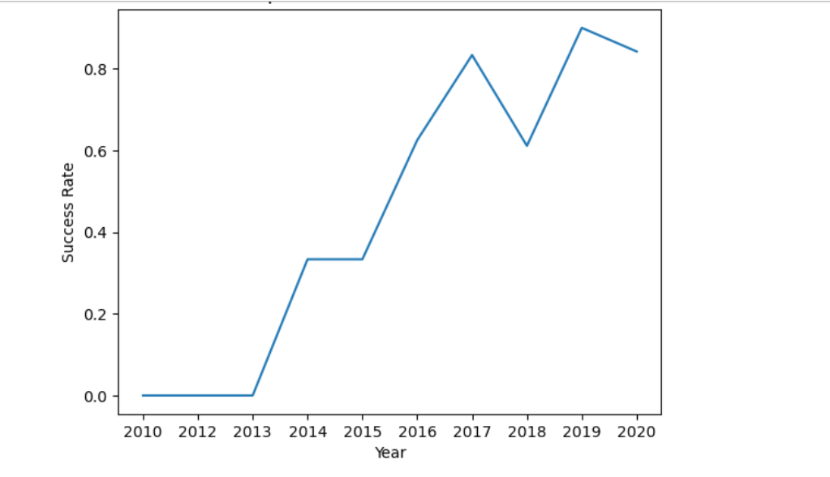
Launch Success Yearly Trend

Slide 24
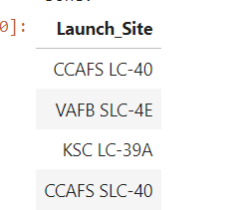
All Launch Site Names

Slide 25
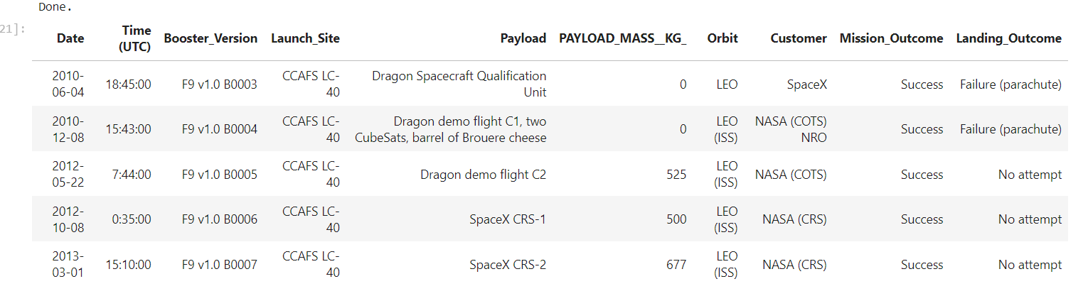
Launch Site Names Begin with 'CCA'
Find 5 records where launch sites begin with `CCA`
Present your query result with a short explanation here

Slide 26
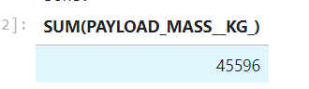
Total Payload Mass

Slide 27
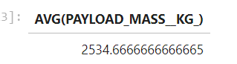
Average Payload Mass by F9 v1.1

Slide 28
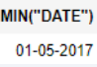
First Successful Ground Landing Date

Slide 29
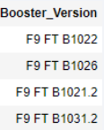
Successful Drone Ship Landing with Payload between 4000 and 6000

Slide 30
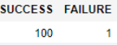
Total Number of Successful and Failure Mission Outcomes

Slide 31
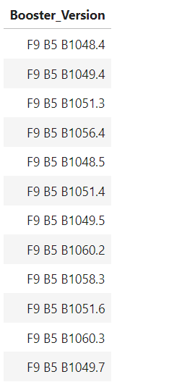
Boosters Carried Maximum Payload

Slide 32
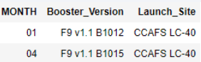
2015 Launch Records

Slide 33
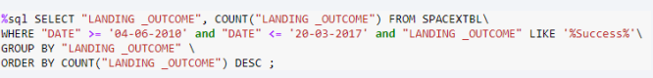
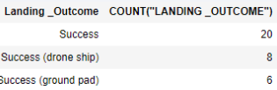
Rank Landing Outcomes Between 2010-06-04 and 2017-03-20

Slide 34

Section 3

Slide 35
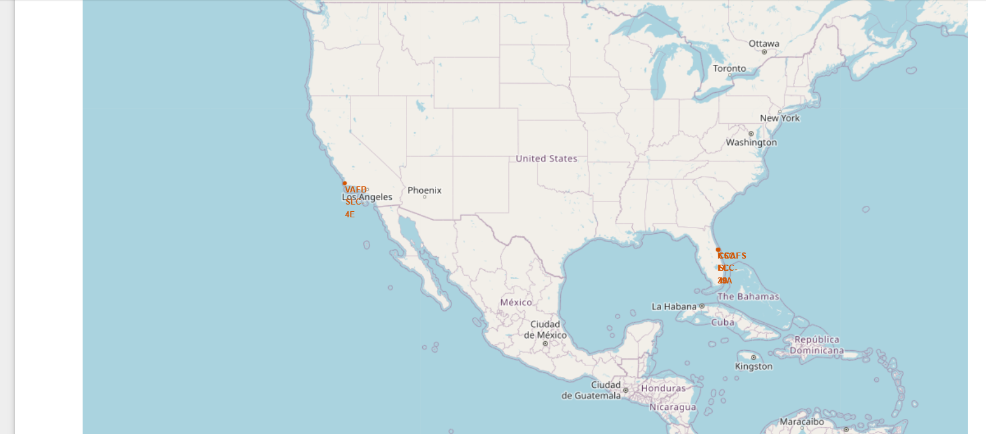
<Folium Map Screenshot 1>

Slide 36
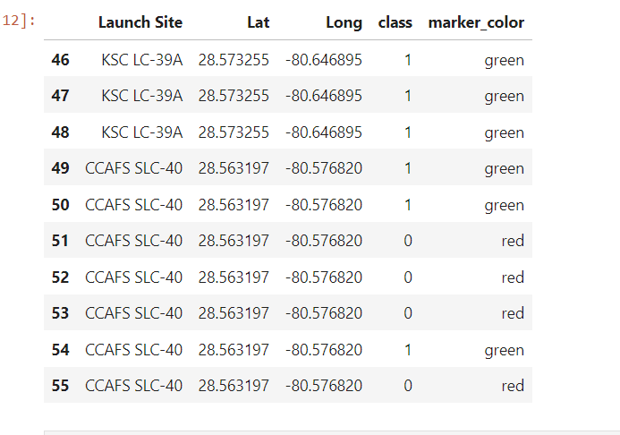
<Folium Map Screenshot 2>

Slide 37
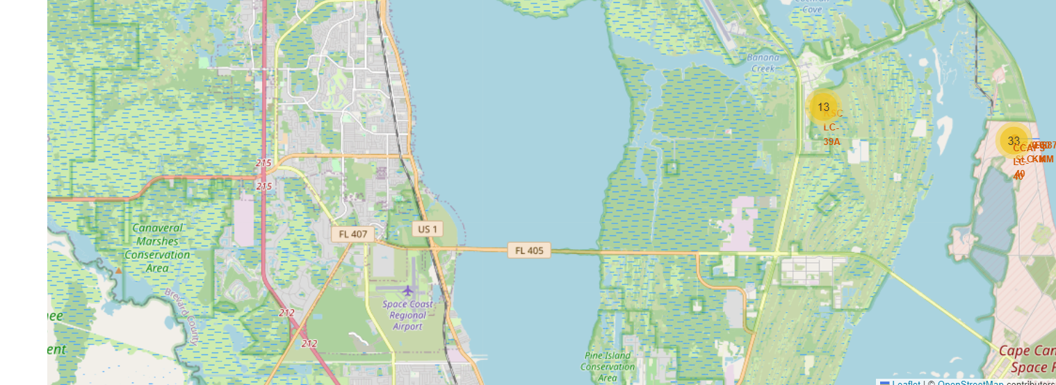
<Folium Map Screenshot 3>

Slide 38

Section 4

Slide 39
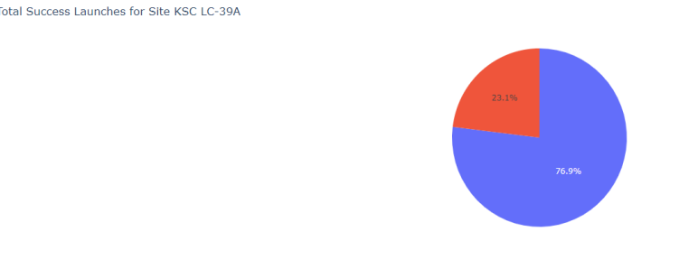
<Dashboard Screenshot 1>

Slide 40
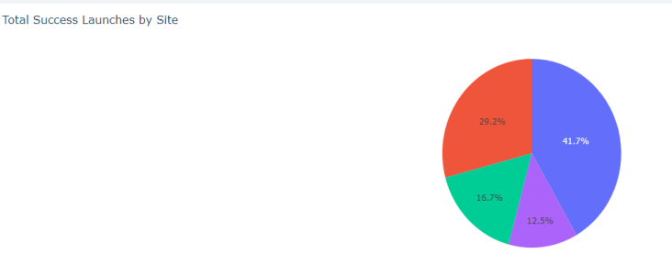
<Dashboard Screenshot 2>

Slide 41
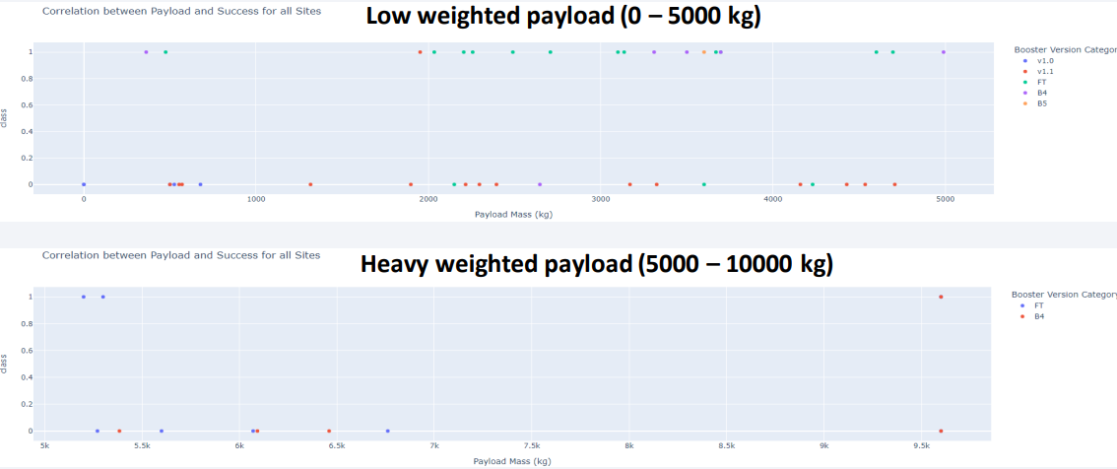
<Dashboard Screenshot 3>

Slide 42

Section 5

Slide 43
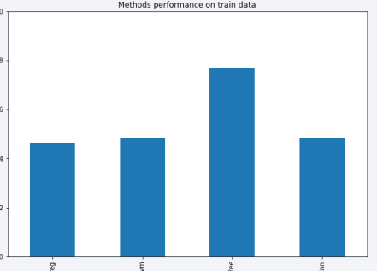
Classification Accuracy

Slide 44
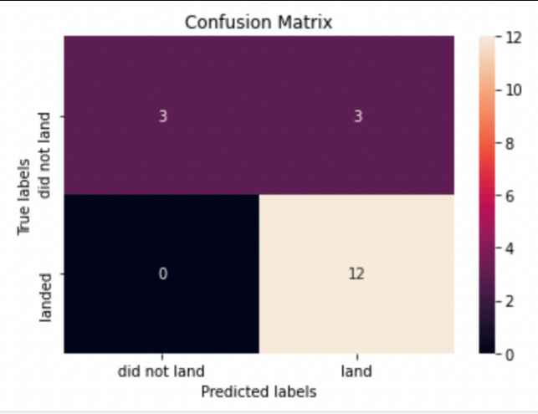
Confusion Matrix

Slide 45
Conclusions
Decision Tree Model is the best algorithm for this dataset.
Launches with a low payload mass show better results than launches with a larger payload mass.
Most of launch sites are in proximity to the Equator line and all the sites are in very close proximity to the coast.
The success rate of launches increases over the years.
KSC LC-39A has the highest success rate of the launches from all the sites.
Orbits ES-L1, GEO, HEO and SSO have 100% success rate

Slide 46
Appendix

Slide 47


